Slide 1
CSE 430 Software Testing and Quality Assurance

Slide 2
Lecture 05
Dynamic Testing: Black-Box Testing Techniques

Slide 3
Testing Techniques
Dynamic testing techniques: is performed with the execution of coded and maps to validation. (black-box and white-box testing)
Static testing techniques: is performed without executing the code and maps to verification
Regression testing techniques: execute all the test cases designed earlier as well as some new cases to check the new modifications

Slide 4
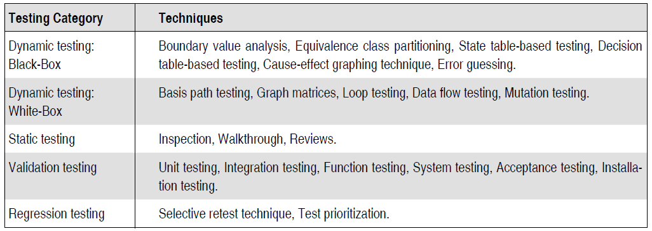
Testing Techniques

Slide 5
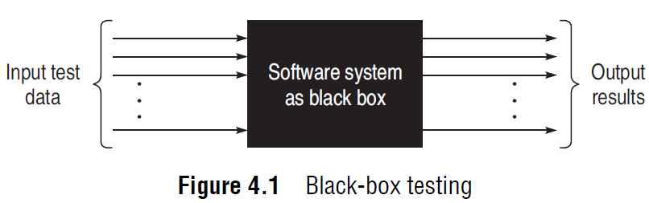
Black-Box Testing
considers only the functional requirements of the software or module
the structure or logic of the software is not considered
also known as functional testing
software system is considered as a black box, taking no notice of its internal structure

Slide 6
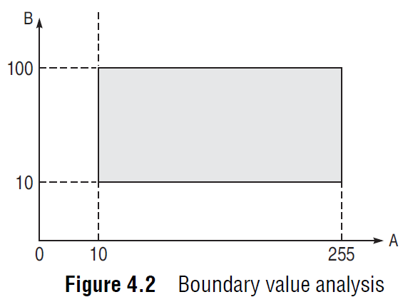
BOUNDARY VALUE ANALYSIS (BVA)
A is an integer between 10 and 255, then boundary checking can be on 10(9, 10, 11) and on 255(256, 255, 254).
B is another integer variable between 10 and 100, then boundary checking can be on 10(9, 10, 11) and 100(99, 100, 101)

Slide 7
BOUNDARY VALUE CHECKING (BVC)
The variable at its extreme value can be selected at:
(a) Minimum value (Min)
(b) Value just above the minimum value (Min+ )
(c) Maximum value (Max)
(d) Value just below the maximum value (Max−)

Slide 8
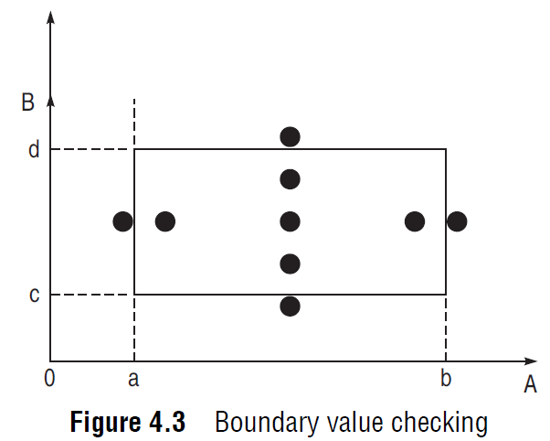
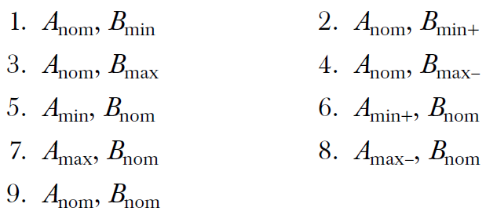
BOUNDARY VALUE CHECKING (BVC)
for n input variables in a module,
4n + 1 test cases can be designed

Slide 9
ROBUSTNESS TESTING METHOD
boundary values are exceeded as:
A value just greater than the Maximum value (Max+)
A value just less than Minimum value (Min−)

Slide 10

ROBUSTNESS TESTING METHOD
for n variables in a module,
6n + 1 test cases can be designed

Slide 11
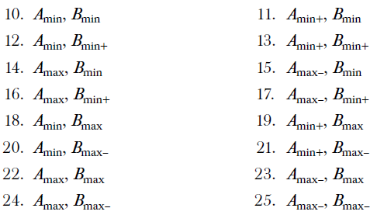
WORST-CASE TESTING METHOD
extend the concept of BVC by assuming more than one variable
on the boundary
for n variables in a module,
5^{n} test cases can be designed

Slide 12
Example 4.1
A program reads an integer number within the range [1,100] and determines whether it is a prime number or not. Design test cases for this program using BVC, robust testing, and worst-case testing methods.

Slide 13
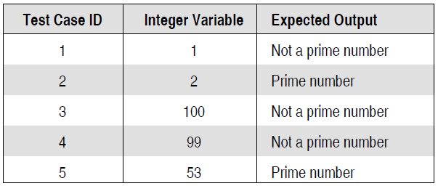
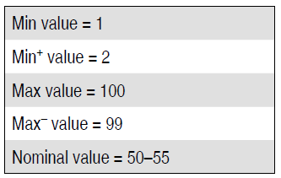
Test cases using BVC
Since there is one variable, the total number of
test cases will be 4n + 1 = 5.

Slide 14
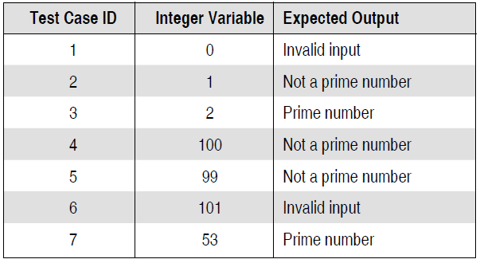
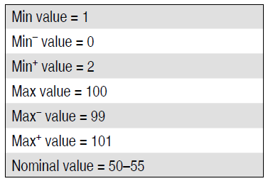
Test cases using robust testing
Since there is one variable, the total number of
test cases will be 6n + 1 = 7.

Slide 15
Test cases using worst-case testing
Since there is one variable, the total number of test cases will be 5^{n} = 5. Therefore, the number of test cases will be same as BVC.

Slide 16
Example 4.2
A program computes a^{b} where a lies in the range [1,10] and b within [1,5]. Design test cases for this program using BVC, robust testing, and worst-case testing methods.

Slide 17
Example 4.3
A program reads three numbers, A, B, and C, within the range [1, 50] and prints the largest number. Design test cases for this program using BVC, robust testing, and worst-case testing methods.

Slide 18
Example 4.4
A program determines the next date in the calendar. Its input is entered in the form of <ddmmyyyy> with the following range:
1 <= mm <= 12
1 <= dd <= 31
1900 <= yyyy <= 2025
Its output would be the next date or it will display ‘invalid date’. Design test cases for this program using BVC, robust testing, and worst-case testing methods.

